Slide 1
Mohit Rahangdale
CHINOOK MUSIC STORE

Slide 2

INTRODUCTION
Established in 1995 in East Wenatchee, catering to musicians and schools in North Central WA.
Focuses on providing band and orchestral instruments, as well as guitars and ukuleles.
Offers lesson services in piano, drums, vocals, among others.
Famous for school rental nights and instrument repair services.

Slide 3
PROBLEM STATEMENT
You are hired as a data analyst at Chinook, and your objective is to analyze music record sales data to gain insights and make recommendations for the company's strategy in the physical music market.

Slide 4
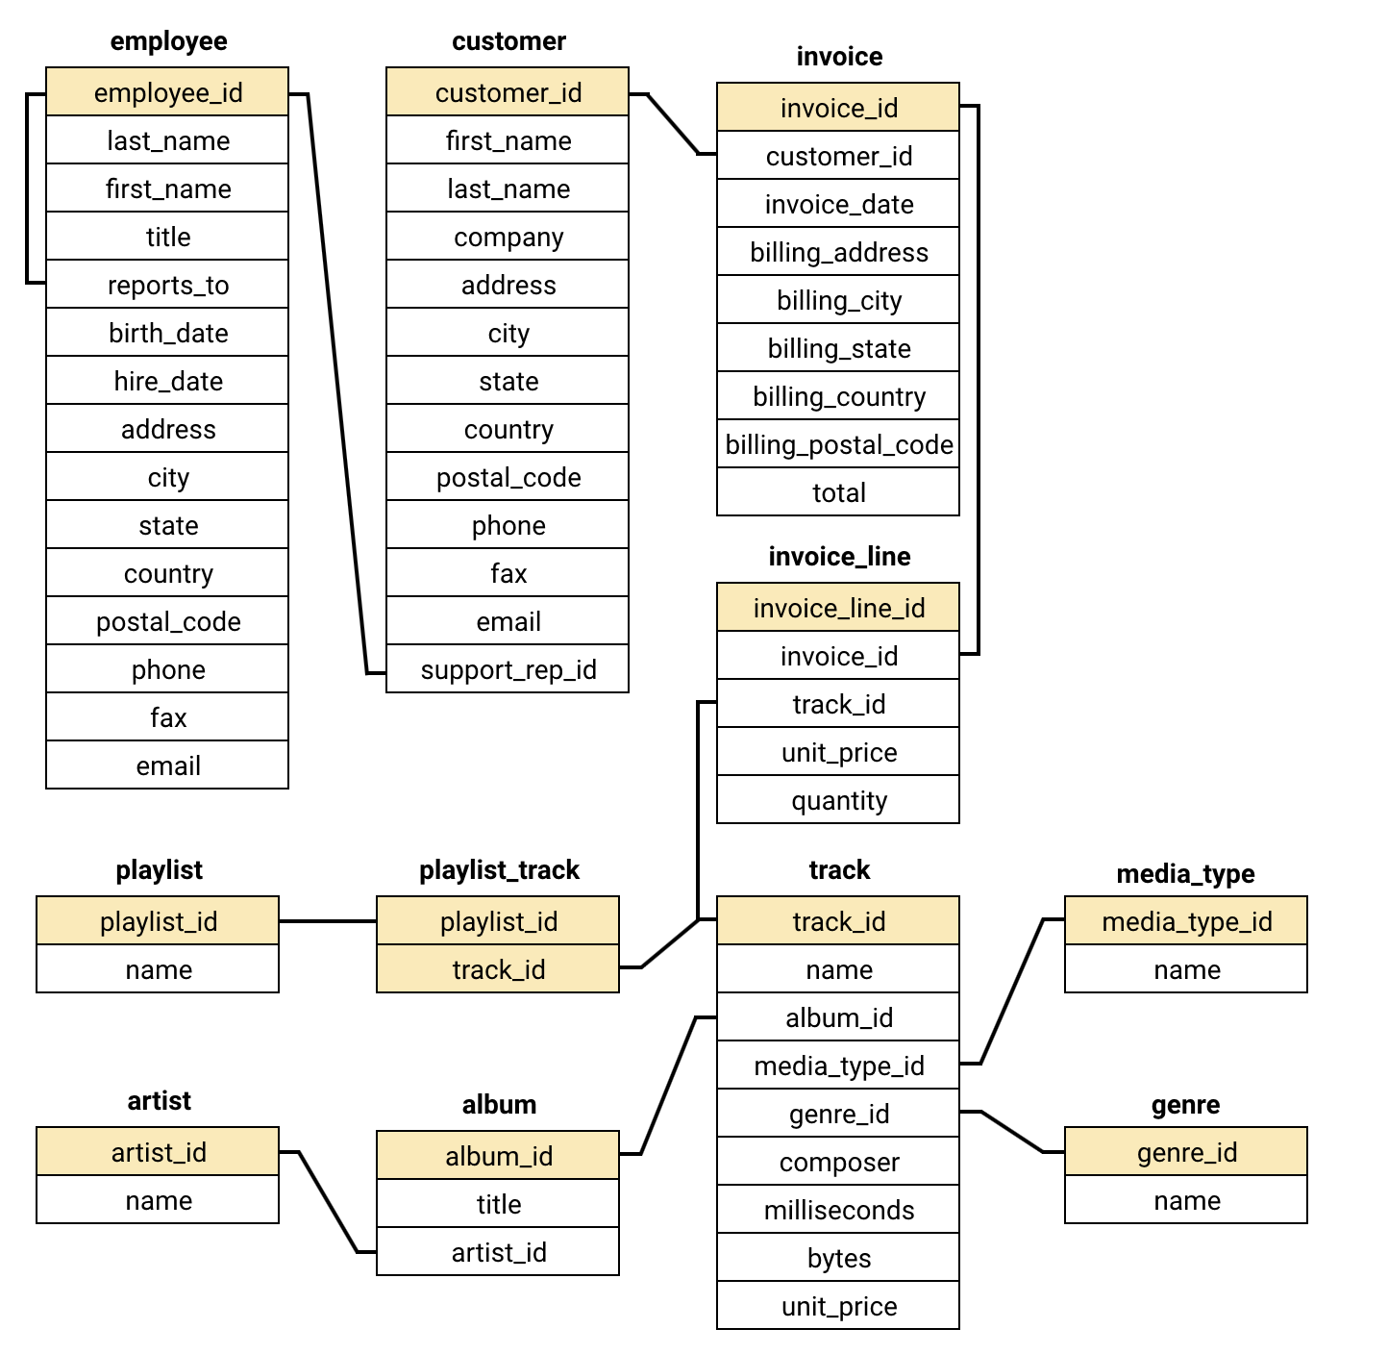
DATABASE SCHEMA

Slide 5
DATA OVERVIEW
Structure: 11 Interconnected Tables to represent a global digital media store.
Customers: 59 distinct customer profiles from 24 different countries worldwide, including USA, Brazil, Canada, Germany, etc.
Invoices: 412 total orders, including revenue, tax, and billing location information.
Product Catalog: 3,503 tracks across 25 genres and 5 media formats.
Relational Integrity: High-quality metadata to link Artists to Albums and Tracks to Invoice Lines.
Global Footprint: The data spans sales and customers in 24 countries.

Slide 6
METHODOLOGY
Data Cleaning: Performed data cleaning by dealing with missing values and duplicates for precision.
Sales and Customer Analysis: Identified high sales areas and conducted customer analysis to determine high-performing regions, VIP customers, and low-active customers.
Trends Analysis: Conducted an analysis on the genre preference trend in the USA, which helped us determine the most loved music genres.
Visualization and Insights: Generated visualizations to communicate insights to the management team.

Slide 7
TOP-SELLING TRACKS IN USA
In USA, “War Pigs” is the most selling track which has a total count of 6.
“You know I’m No Good” track is the second most selling track.
“I Looked At You”, “Scentless Apprentice” and “Violent Pornography” are the remaining tracks which have total count of 4.

Slide 8
TOP-ARTISTS IN USA
In USA, Cake is the most selling artist which has a total count of 6.
Amry Winehouse is the second most selling artist in USA.
System of A Down, The Doors and Nirvana are the remaining artists which have total count of 4.

Slide 9
TOP 5 COUNTRY REVENUE WISE
USA is the leading country in terms of revenue.
Brazil got the second most revenue.
Canada is third in total revenue.
The other countries are France, followed by Germany

Slide 10
Sales in Different Genre
The genre which has the most revenue is Rock.
Alternative & Punk and Metal are the second and third in the list.
TV shows are the last in the list of revenue generation.

Slide 11
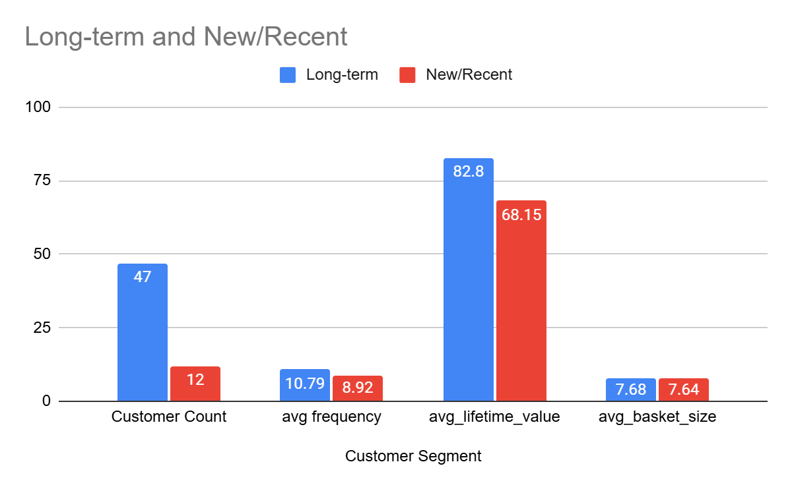
Customer Segment Comparison: Long-term vs New Customers
The long-term buyers are increasingly active.
Their lifetime value is greater.
There is parity in the basket size of both types of buyers.

Slide 12
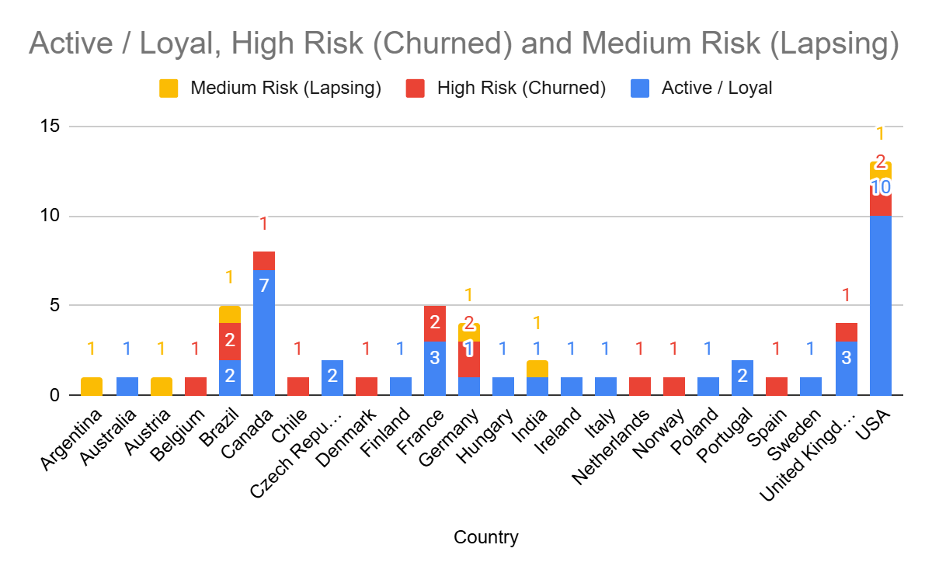
Customer Risk Segmentation by Country
The loyal ones comprise the majority, thus representing stability.
There is a significant number of those who have a higher tendency to churn.
There are certain markets where activities and churning are relatively high.

Slide 13
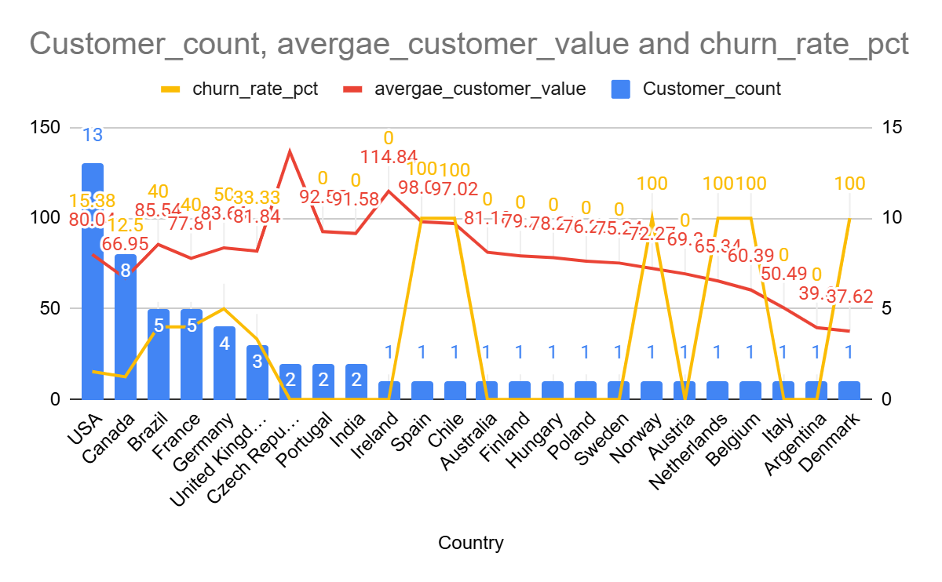
Customer Distribution, Value & Churn Analysis by Country
USA has the highest number of customers; most countries have low volume.
Customer value differs from one market to another.
High churn rates in specific regions reflect retention problems

Slide 14
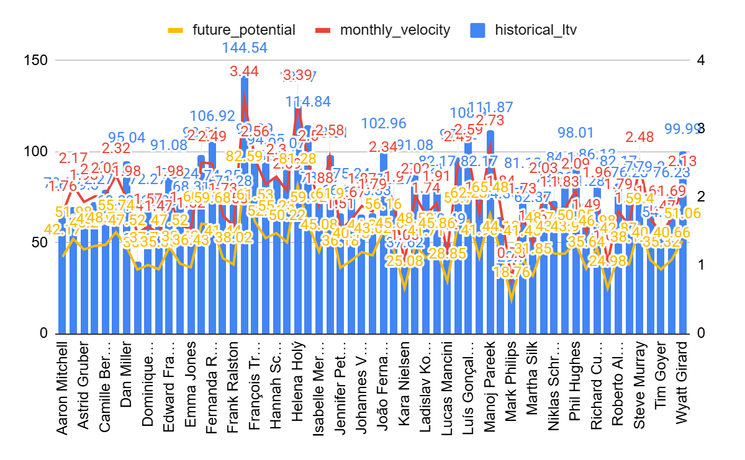
Customer Value, Velocity & Future Potential Analysis
The LTV is not consistent; very few people represent significant value.
Velocity per month is generally consistent.
The future potential for different customers is not consistent.

Slide 15
STRATEGIC RECOMMENDATIONS
Use Rock Genre: Increase Rock genre selection and promote other similar genres such as Alternative and Metal.
Loyalty Program for High-Value Customers: Develop loyalty programs for customers who have high spending potential.
Re-win Strategy: Re-win strategy for inactive customers with emails and discounts.
Geographical Targeting: Invest more in marketing in cities that generate high revenue.

Slide 16
CONCLUSION
Data Integrity: The data cleansing process and the elimination of duplicates helped ensure that all analysis was performed based on unique customer activity.
Rock as a Revenue Generator: In the United States, rock is still the highest-performing genre, which means it is an important focus when it comes to increasing revenues and maximizing profitability.
Retention Opportunities: Analysis provided important insight into geographic areas with significant upside, allowing us to address customers at risk of attrition.
Insights-Driven Decisions: Having gained insights into the dataset, we can now make decisions based on them.

Slide 17
Data Problems and Their Resolution
Lack of Metadata: Managed null entries in Company and Composer through COALESCE to provide clear reporting results.
Duplicate Entries: Eliminated duplicate records that had identical names/emails through ROW_NUMBER().
Inflexibility of Static Data: Resolved the issue related to the unavailability of CURRENT_DATE for analysis of churn rate.
Recency Calculation Correction: Calculated a 180-day window based on the Latest Purchase Date.

Slide 18
THANK YOU!

